Slide 1


Haider Sultan
30/11/22

Slide 2

Outline
Executive Summary
Introduction
Methodology
Results
Conclusion
Appendix

Slide 3
Executive Summary
Summary of methodologies:
Collection of Data
Data wrangling
Exploratory Data Analysis:
SQL
Data Visualization
Building interactive map with Folium
Building a Dashboard with Dash(Plotly)
Building Classification Models
Summary of all results:
Exploratory data analysis results
Predictive analysis results

Slide 4
Introduction
Project background and context:
Space travel may soon be a possibility for common folks on this planet since the arrival of commercial space travel. Space X is currently leading this industry with prices as low as $62 million as compared to the $165 million charged by other providers.
This is mainly due to Space X’s ability to recover part of rocket. If we can predict whether the first stage will land successfully, then we can determine the overall cost of the launch more effectively. Space Y can use this information to compete with SpaceX.
Problems you want to find answers:
We want to figure out which variables affect out predicted outcomes the most and then determine the conditions to attain best results and ultimately predicting the success rate of Stage 1.

Slide 5

Section 1

Slide 6
Methodology
Executive Summary
Data collection methodology:
We Combined data from SpaceX public API and used BeautifulSoup to scrape SpaceX Wikipedia page.
Perform data wrangling
Generated Training labels by classifying landing as Successful/Unsuccessful
Perform exploratory data analysis (EDA) using visualization and SQL
Perform interactive visual analytics using Folium and Plotly Dash
Perform predictive analysis using classification models
Used GridSearchCV to find the best Hyperparameters for our models.

Slide 7
Data Collection
The data collection process includes a combination of API requests from the SpaceX API and web scraping data from a table in the Wikipedia page of SpaceX, Falcon 9 and Falcon Heavy Launches Records using BeautifulSoup.
SpaceX API:
Request data from SpaceX API
Data is returned in the form of a .JSON
Data is Normalized and saved
Web Scraping:
Get HTML response from the URL
Extract data using BS4
Normalize and save as CSV

Slide 8
Data Collection – SpaceX API
Requesting rocket launch data from SpaceX API
Converting Response to a JSON file
Cleaning the data using custom functions.
Github Link:
https://github.com/Hyde06/Capstone_SpaceX/blob/master/Capstone%20Project%20:%20SpaceX%20REST%20API.ipynb
Combining the columns into a dictionary to create data frame
Filtering dataframe to only include Falcon 9 launches.
Imputing missing values and saving to CSV

Slide 9
Data Collection - Scraping
Request Wikipedia
html
Creating a BeautifulSoup object with HTML parser.
Finding all tables and assigning the result to a list
Create an empty dictionary with keys.
Iterate through table cells to extract data to dictionary
Github URL:
https://github.com/Hyde06/Capstone_SpaceX/blob/master/Capstone%20Project%20:%20Data%20Collection%20using%20bs4.ipynb

Slide 10
Data Wrangling
Create a training label with landing outcomes where successful = 1 & failure = 0.
Outcome column has two components: ‘Mission Outcome’ ‘Landing Location’
New training label column ‘class’ with a value of 1 if ‘Mission Outcome’ is True and 0 otherwise.
Value Mapping:
True ASDS, True RTLS, & True Ocean – set to -> 1
None None, False ASDS, None ASDS, False Ocean, False RTLS – set to -> 0
Calculating the success rate for every landing in dataset.
Github Link:
https://github.com/Hyde06/Capstone_SpaceX/blob/master/Project%20-%20Data%20Wrangling.ipynb

Slide 11
EDA with Data Visualization
Performed exploratory data analysis on dataset variables such as Flight number, Payload Mass, Orbit, Launch Site, Year and Class.
Used Scatter plots, line charts and bar plots to determine any correlation between variables such as:
Flight Number vs. Payload Mass,
Flight Number vs. Launch Site,
Payload Mass vs. Launch Site,
Orbit vs. Success Rate,
Flight Number vs. Orbit,
Payload vs Orbit,
Year vs Success Rate
Github URL:
https://github.com/Hyde06/Capstone_SpaceX/blob/master/EDA%20with%20Python%20Libraries.ipynb

Slide 12
EDA with SQL
Loaded data set into IBM DB2 Database and queried using SQL Python integration.
Queries were made to get a better understanding of the dataset.
Queried information about launch site names, mission outcomes, various pay load sizes of customers and booster versions, and landing outcomes.
Github Link:
https://github.com/Hyde06/Capstone_SpaceX/blob/master/EDA%20with%20SQL.ipynb

Slide 13
Build an Interactive Map with Folium
Created objects and added to a folium map:
Markers for all launch sites on a map
Markers for the success/failed launches for each site on the map
Lines showing the distances between a launch site to its proximities
This allows us to understand why launch sites may be located where they are. Also visualizes successful landings relative to location.
Github Link:
https://github.com/Hyde06/Capstone_SpaceX/blob/master/Data%20Visualization%20-%20Folium.ipynb

Slide 14
Build a Dashboard with Plotly Dash
Created Dashboards using Plotly Dash.
It included a Pie chart and a Scatter Plot
Pie chart can be selected to show distribution of successful landings across all launch sites.
Scatter plot shows the relationship between Outcomes and Payload mass (Kg) by different boosters

Slide 15
Predictive Analysis (Classification)
Split label ‘Class’ as our Y variable.
Use Standard Scaler on our features.
Train/Test split the data
Build models and evaluate it.
Use GridSearchCV for finding optimum parameters
Plot Confusion matrix for all models.
Github URL:
https://github.com/Hyde06/Capstone_SpaceX/blob/master/Machine%20Learning%20Models.ipynb

Slide 16
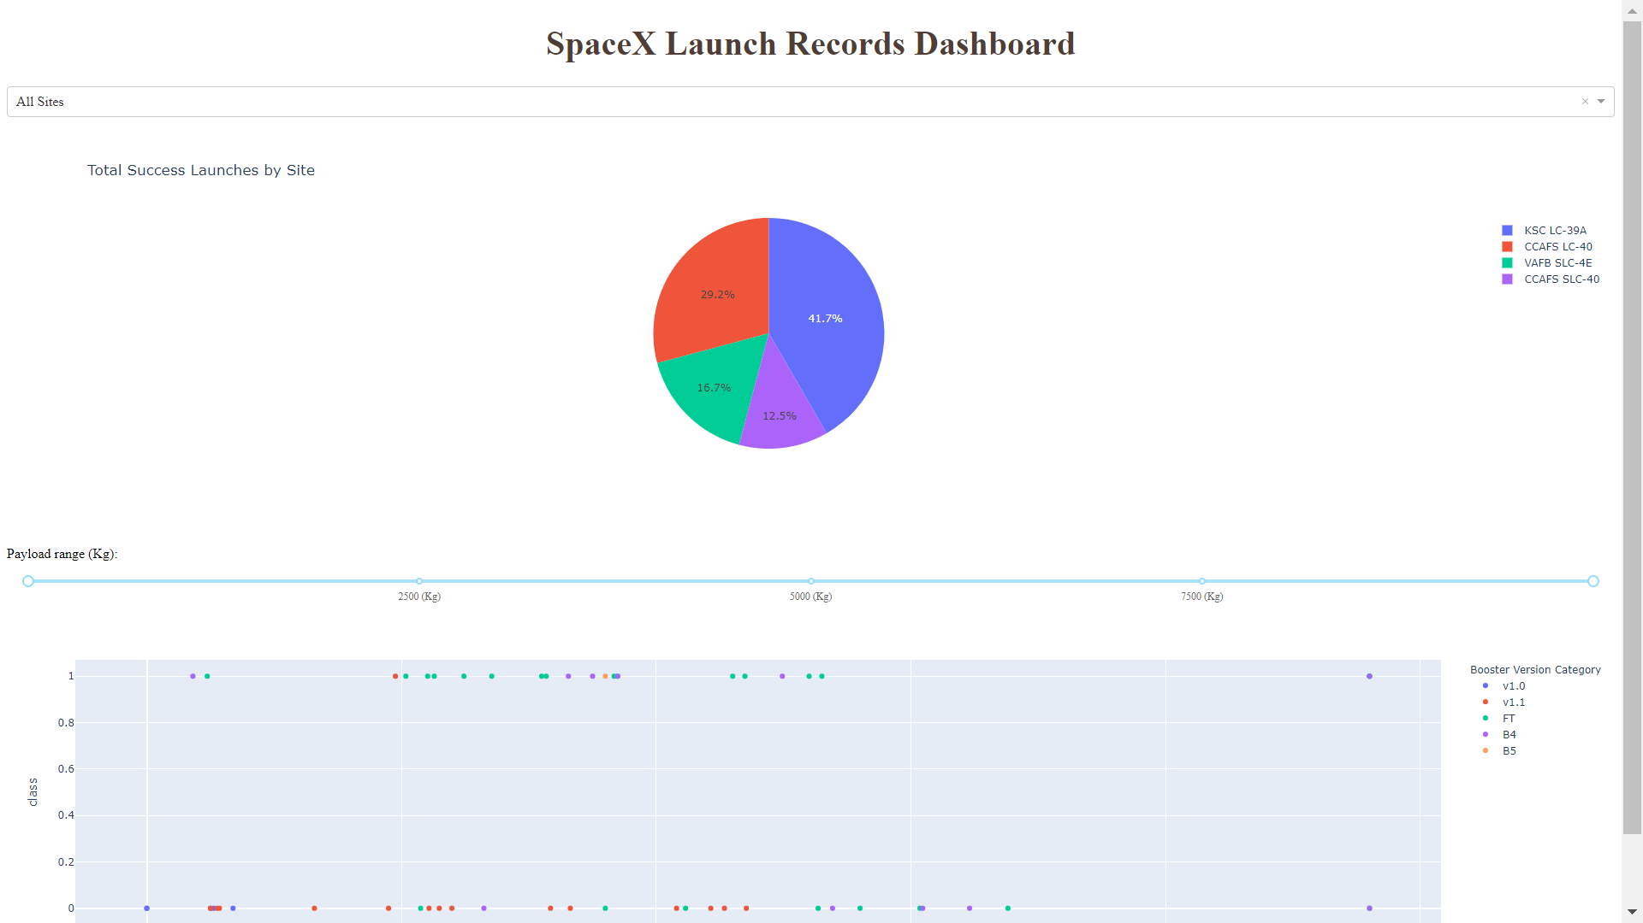
Results
Plotly Dashboard is shown above. Comparing the accuracy of the four methods, all return the same accuracy of about 83% for test data.

Slide 17

Section 2

Slide 18
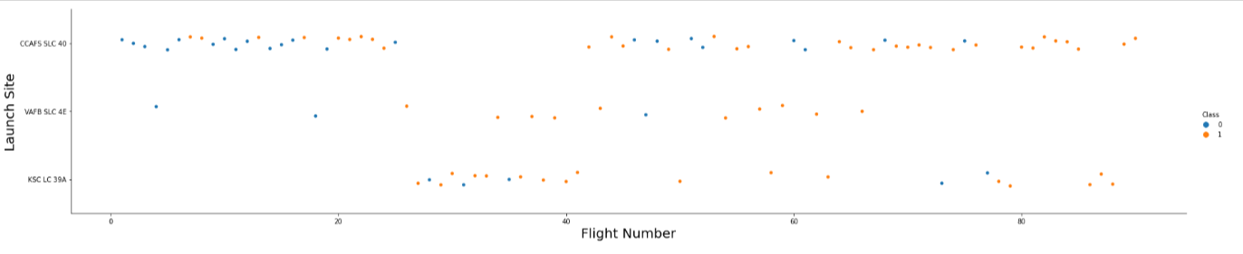
Flight Number vs. Launch Site
Graphic suggests an increase in success rate over time (indicated in Flight Number). Likely a big breakthrough around flight 20 which significantly increased success rate. CCAFS appears to be the main launch site as it has the most volume.

Slide 19
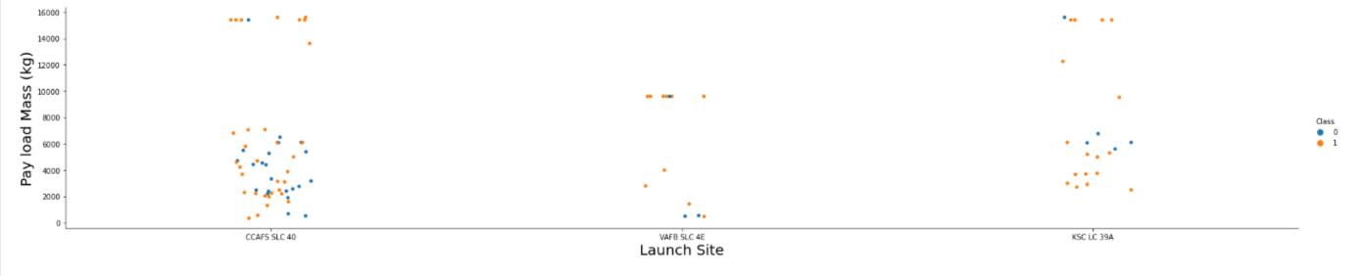
Payload vs. Launch Site
In VAFB-SLC launch site, there are no rockets launched for heavy payload mass(greater than 10000).
Payload mass appears to fall mostly between 0-6000 kg. Different launch sites also seem to use different payload mass.

Slide 20
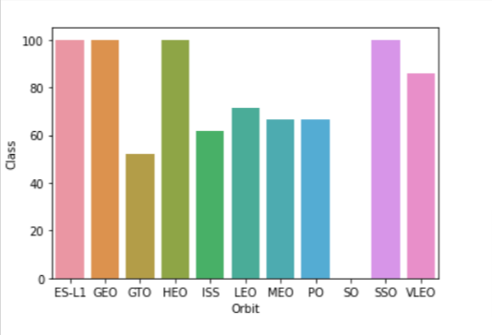
Success Rate vs. Orbit Type
Orbit types SSO, HEO, GEO, and ES-L1 have the highest success rates (100%).
GTO (27) has the around 50% success rate but largest sample.
SO (1) has 0% success rate

Slide 21
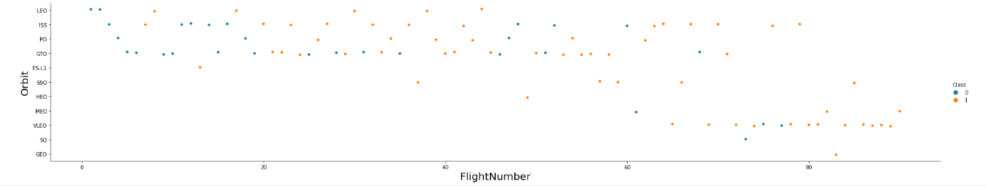
Flight Number vs. Orbit Type
Launch Orbit preferences changed over Flight Number.
LEO orbit the Success appears related to the number of flights; on the other hand, there seems to be no relationship between flight number when in GTO orbit.

Slide 22
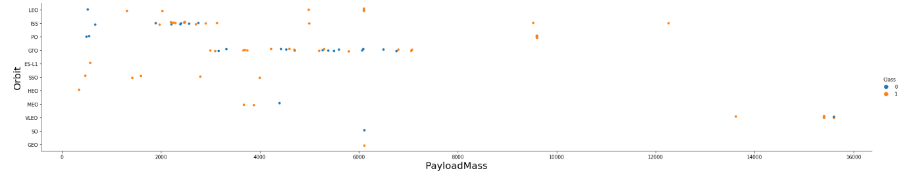
Payload vs. Orbit Type
Payload mass seems to correlate with orbit
With heavy payloads the successful landing or positive landing rate are more for Polar,LEO and ISS.
However for GTO we cannot distinguish this well as both positive landing rate and negative landing(unsuccessful mission) are both there here.

Slide 23
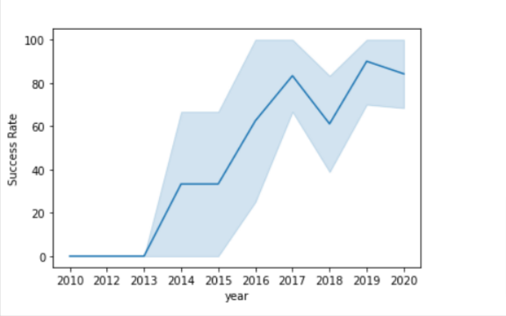
Launch Success Yearly Trend
Since 2013, the success rate has continued to increase until 2017.
The rate decreased slightly in 2018.
Recently, it has shown a success rate of about 80%.
The success rate since 2013 kept increasing till 2020.

Slide 24
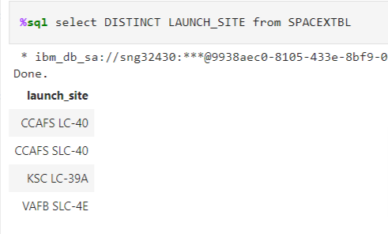
All Launch Site Names
Query unique launch site names from database.
There are four unique launch sites: CCAFS LC-40, CCAFS SLC-40, KSC LC-39A, VAFB SLC-4E

Slide 25
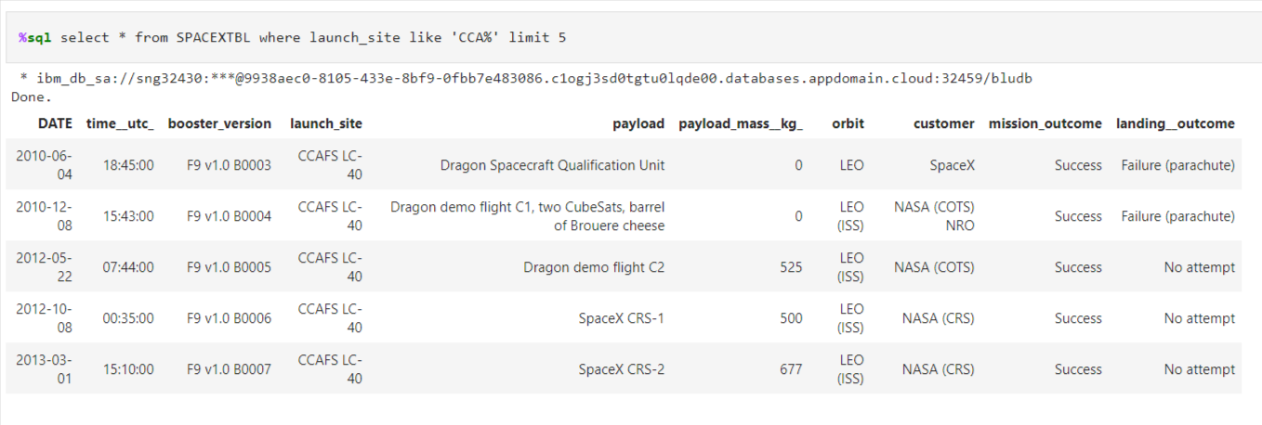
Launch Site Names Begin with 'CCA'
Only five records of the SpaceX table were displayed using LIMIT 5 clause in the query.

Slide 26
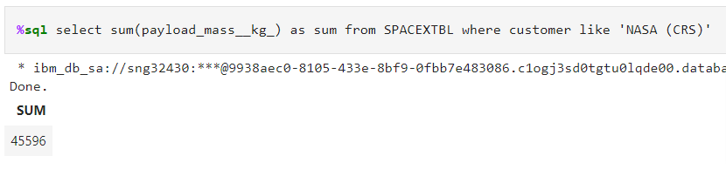
Total Payload Mass
Using the SUM() function to calculate the sum of column PAYLOAD_MASS__KG_.

Slide 27
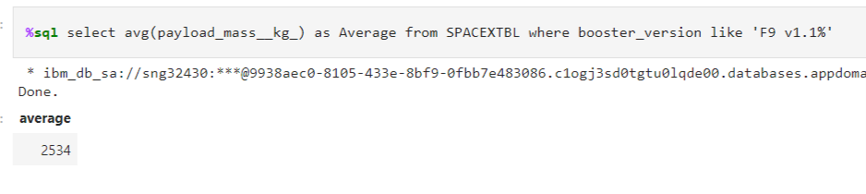
Average Payload Mass by F9 v1.1
Using the AVG() function to calculate the average value of column PAYLOAD_MASS__KG_ with a WHERE clause as well.

Slide 28
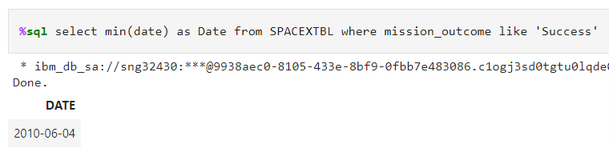
First Successful Ground Landing Date
This query returns the first successful ground pad landing date.
Using the MIN() function to find out the earliest date in the column DATE.

Slide 29
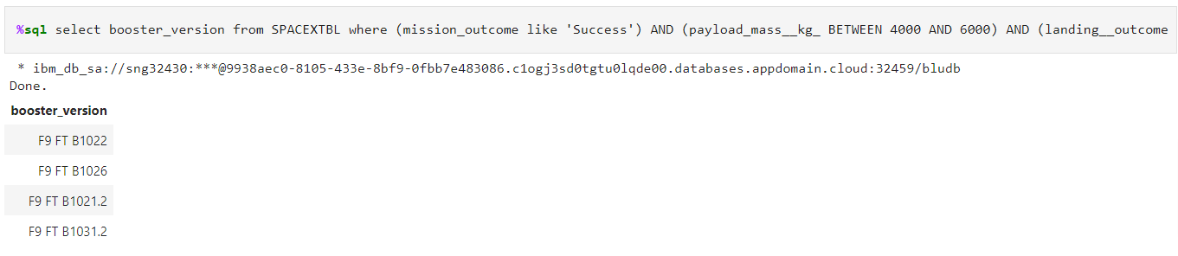
Successful Drone Ship Landing with Payload between 4000 and 6000
This query returns the four booster versions that had successful drone ship landings and a payload mass between 4000 and 6000.

Slide 30
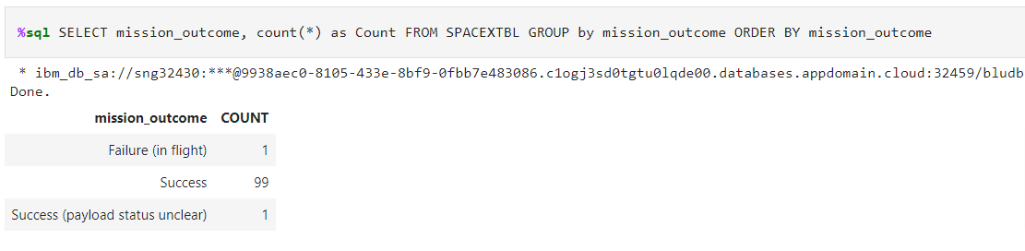
Total Number of Successful and Failure Mission Outcomes
Using the COUNT() function to calculate the total number of columns.
According to the result, SpaceX seems to have successfully completed 99 of its missions.

Slide 31
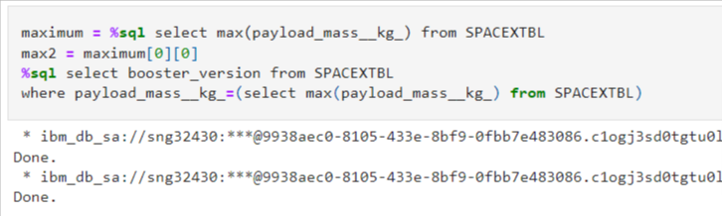
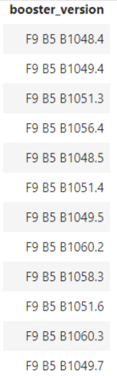
Boosters Carried Maximum Payload
This query returns the booster versions that carried the highest payload mass of 15600 kg.
These booster versions are very similar and all are of the F9 B5 B10xx.x variety.

Slide 32
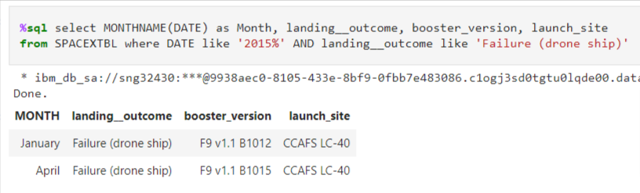
2015 Launch Records
This query returns the Month, Landing Outcome, Booster Version, Payload Mass (kg), and Launch site of 2015 launches where stage 1 failed to land on a drone ship.
Returned 2 such occurrences.

Slide 33
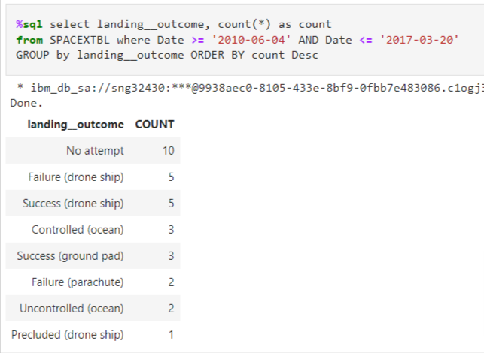
Rank Landing Outcomes Between 2010-06-04 and 2017-03-20
This query returns a list of successful landings and between 2010-06-04 and 2017-03-20 inclusively.
According to the results, the number of successes and failures between 2010-06-04 and 2017-03-20 was similar.

Slide 34

Section 3

Slide 35
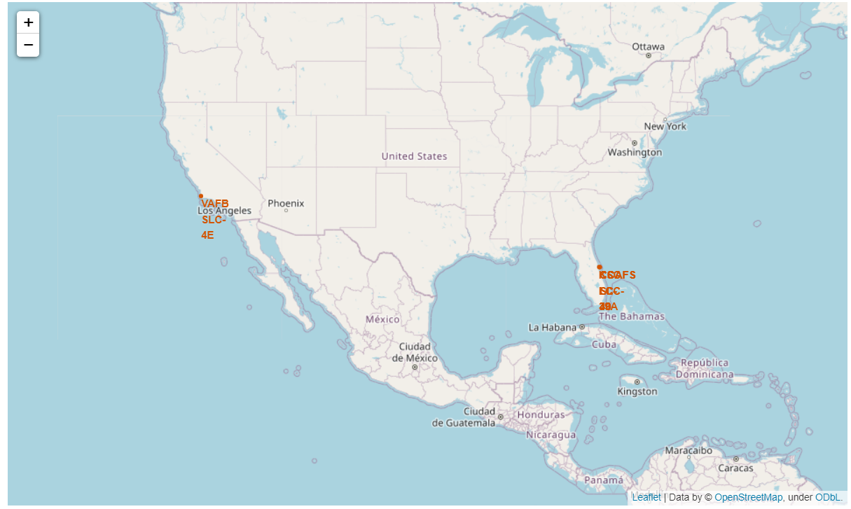
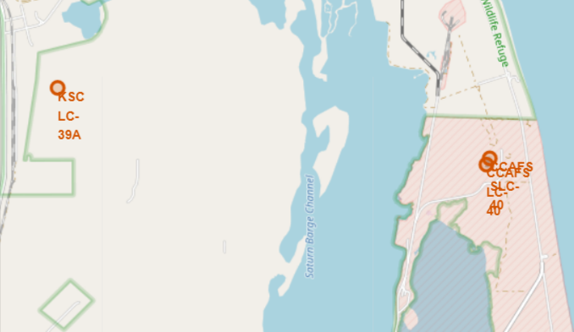
<Folium Map Screenshot 1>
The left map shows all launch sites relative US map. The right map shows the two Florida launch sites since they are very close to each other. All launch sites are near the ocean.

Slide 36
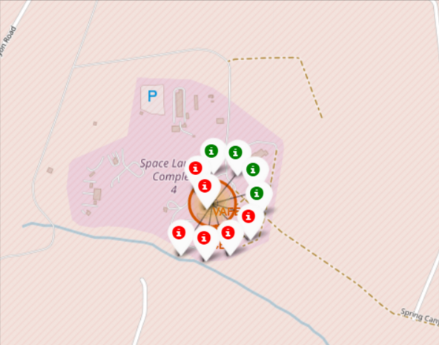
<Folium Map Screenshot 2>
Clusters on Folium map can be clicked on to display each successful landing (green icon) and failed landing (red icon). In this example VAFB SLC-4E shows 4 successful landings and 6 failed landings.

Slide 37

Section 4

Slide 38


Successful Launches Across Launch Sites

Slide 39

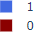
Highest Success Rate Launch Site

Slide 40

Payload Mass vs. Success vs. Booster Version Category

Slide 41

Section 5

Slide 42
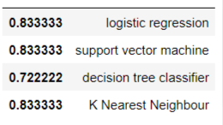
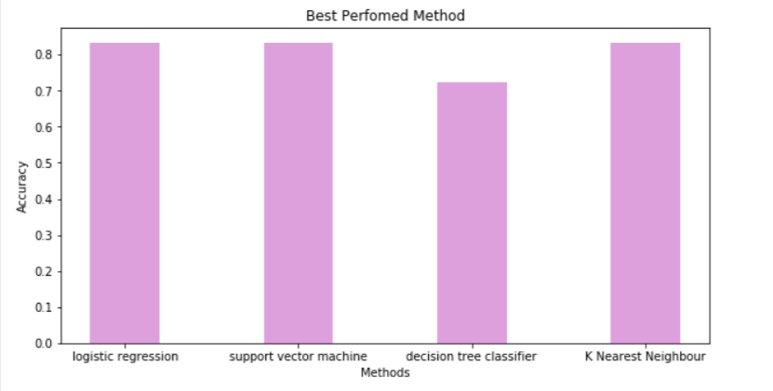
Classification Accuracy
In the test set, the accuracy of all models was virtually the same at 83.33%.(Decision tree gives varying accuracy)
It should be noted that the test size was small at 18.
Therefore, more data is needed to determine the optimal model.

Slide 43

Confusion Matrix
Since all models performed the same for the test set, the confusion matrix is the same across all models. The models predicted 12 successful landings when the true label was successful landing.

Slide 44
Conclusions
As the number of flights increased, the success rate increased, and recently it has exceeded 80%.
Orbital types SSO, HEO, GEO, and ES-L1 have the highest success rate (100%).
Created data labels and stored data into a DB2 SQL database
Created a dashboard for visualization
In this dataset, all models have the same accuracy (83.33%), but it seems that more data is needed to determine the optimal model due to the small data size.
KSLC-39A has the highest number of launch successes and the highest success rate among all sites.
The launch success rate of low weighted payloads is higher than that of heavy weighted payloads.

Slide 45
Appendix
Github URL:
https://github.com/Hyde06/Capstone_SpaceX
Coursera Applied Data Science Capstone Course URL:
https://www.coursera.org/professional-certificates/ibm-data-science?

Slide 46


